Slide 1



Example
We will use the same previous example

Slide 2
Example

Slide 3
Example

Slide 4
Example
As seen from the previous figure, both branches has a sub-sample with a one decision value either YES or NO, so we can convert the node to a terminal node. Let us deal now with the rain outlook branch:

Slide 5
Example
Similarly to what we have done so far we will take the sub-sample of rain outlook to
compute the gini scores for temperature, humidity and wind given a rain outlook.
By computing the gini scores, it turned out to be:
Gini(Outlook=Rain and Temp.) = (2/5)x0.5 + (3/5)x0.444 = 0.466
Gini(Outlook=Rain and Humidity) = (2/5)x0.5 + (3/5)x0.444 = 0.466
Gini(Outlook=Rain and Wind) = (3/5)x0 + (2/5)x0 = 0
This shows that Wind feature has the lowest gini score which defines the best splitter.

Slide 6
Example
As we can notice, the two branches of the wind feature are having sub-samples with YES or NO only decisions so we can convert them to a terminal nodes.
Our final decision tree is as shown in the following figure. What can you conclude?

Slide 7
Regression Trees
So far we have said that we have different impurity measurements like information gain in or Gini index in CART .
However these measurements are valid in classification tasks.
For regression trees, common impurity measure is used:
Least squares which is like minimizing residual sum of squares we have
done in linear models.
Remember that least squares equation is
Where RSS is the abbreviation of Residual sum of squares which represents the squared
error.
We should minimize this equation to find the best split

Slide 8
Decision Trees
Disadvantages of Decision Tree :
They are unstable, meaning that a small change in the data can lead to a large change in the structure of the optimal decision tree.
Sometimes they are often relatively inaccurate. Many other predictors perform better with similar data.
Calculations can get very complex, particularly if many values are uncertain and/or if many outcomes are linked.

Slide 9
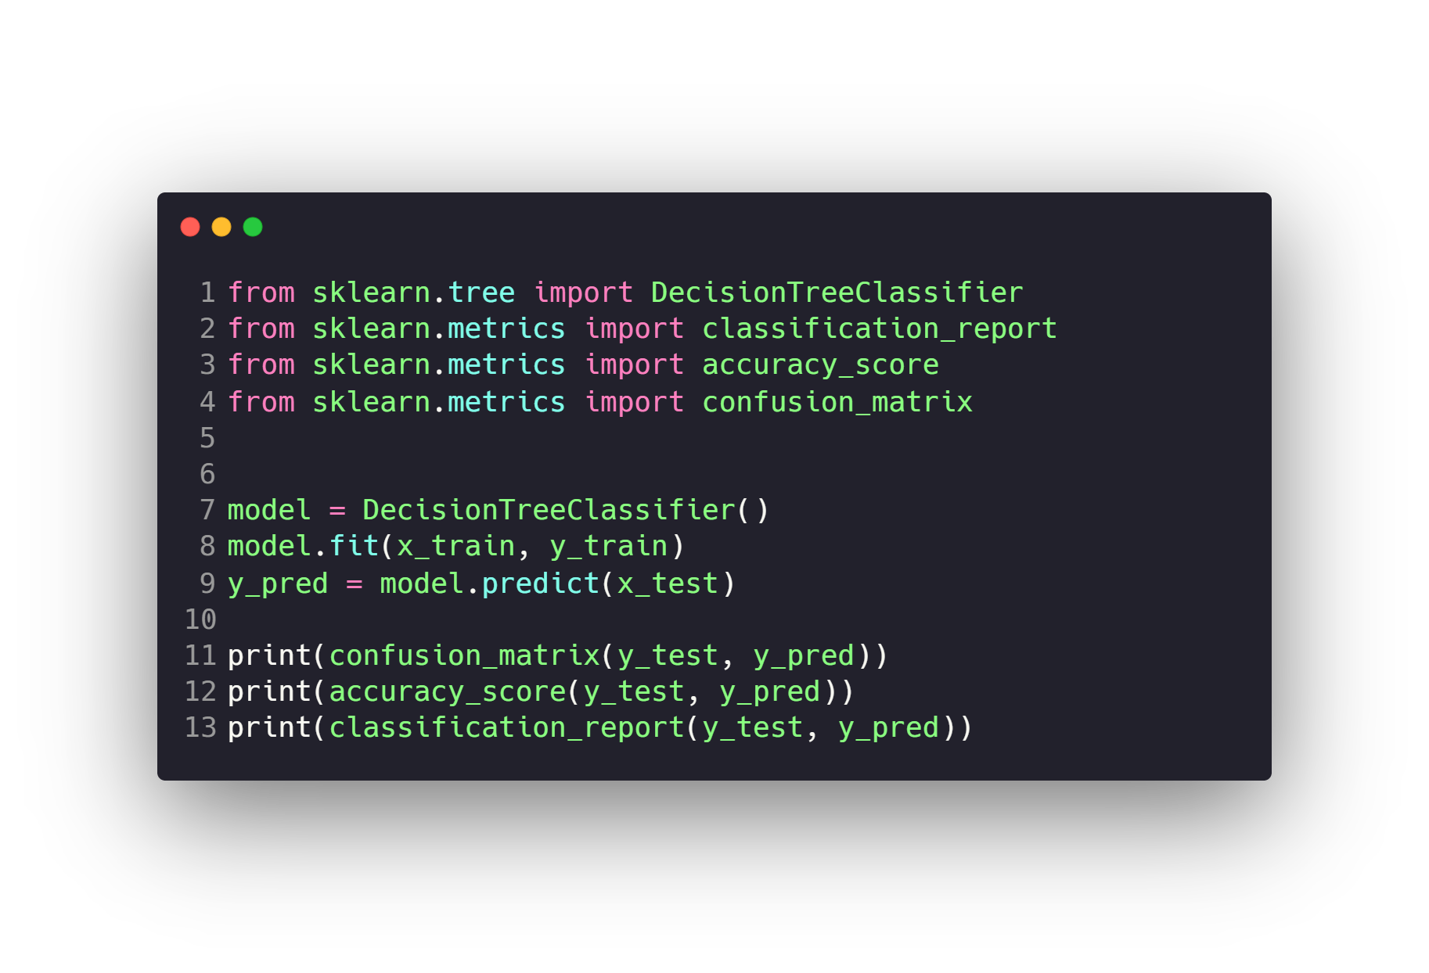
Decision Trees

Slide 10
Questions ?!

